Slide 1
PROJECT: Miniature Uninterruptible Power Supply (UPS)

Slide 2
Group 01
Md. Naimul Islam
Nasif Zawad
ID: 20200105218
ID: 20200105222
Tasdik Hossain
Mehrin Islam
ID: 20200105220
ID: 20200105223
Humayra Tabassum
Mohammad Misbah Uddin
ID: 20200105221
ID: 190205137

Slide 3
Contents
Introduction | UPS vs IPS
Component List | Importance of UPS
Circuit Diagram (including physical view) | Real life Implements
Working Principle | Conclusion
Overview

Slide 4
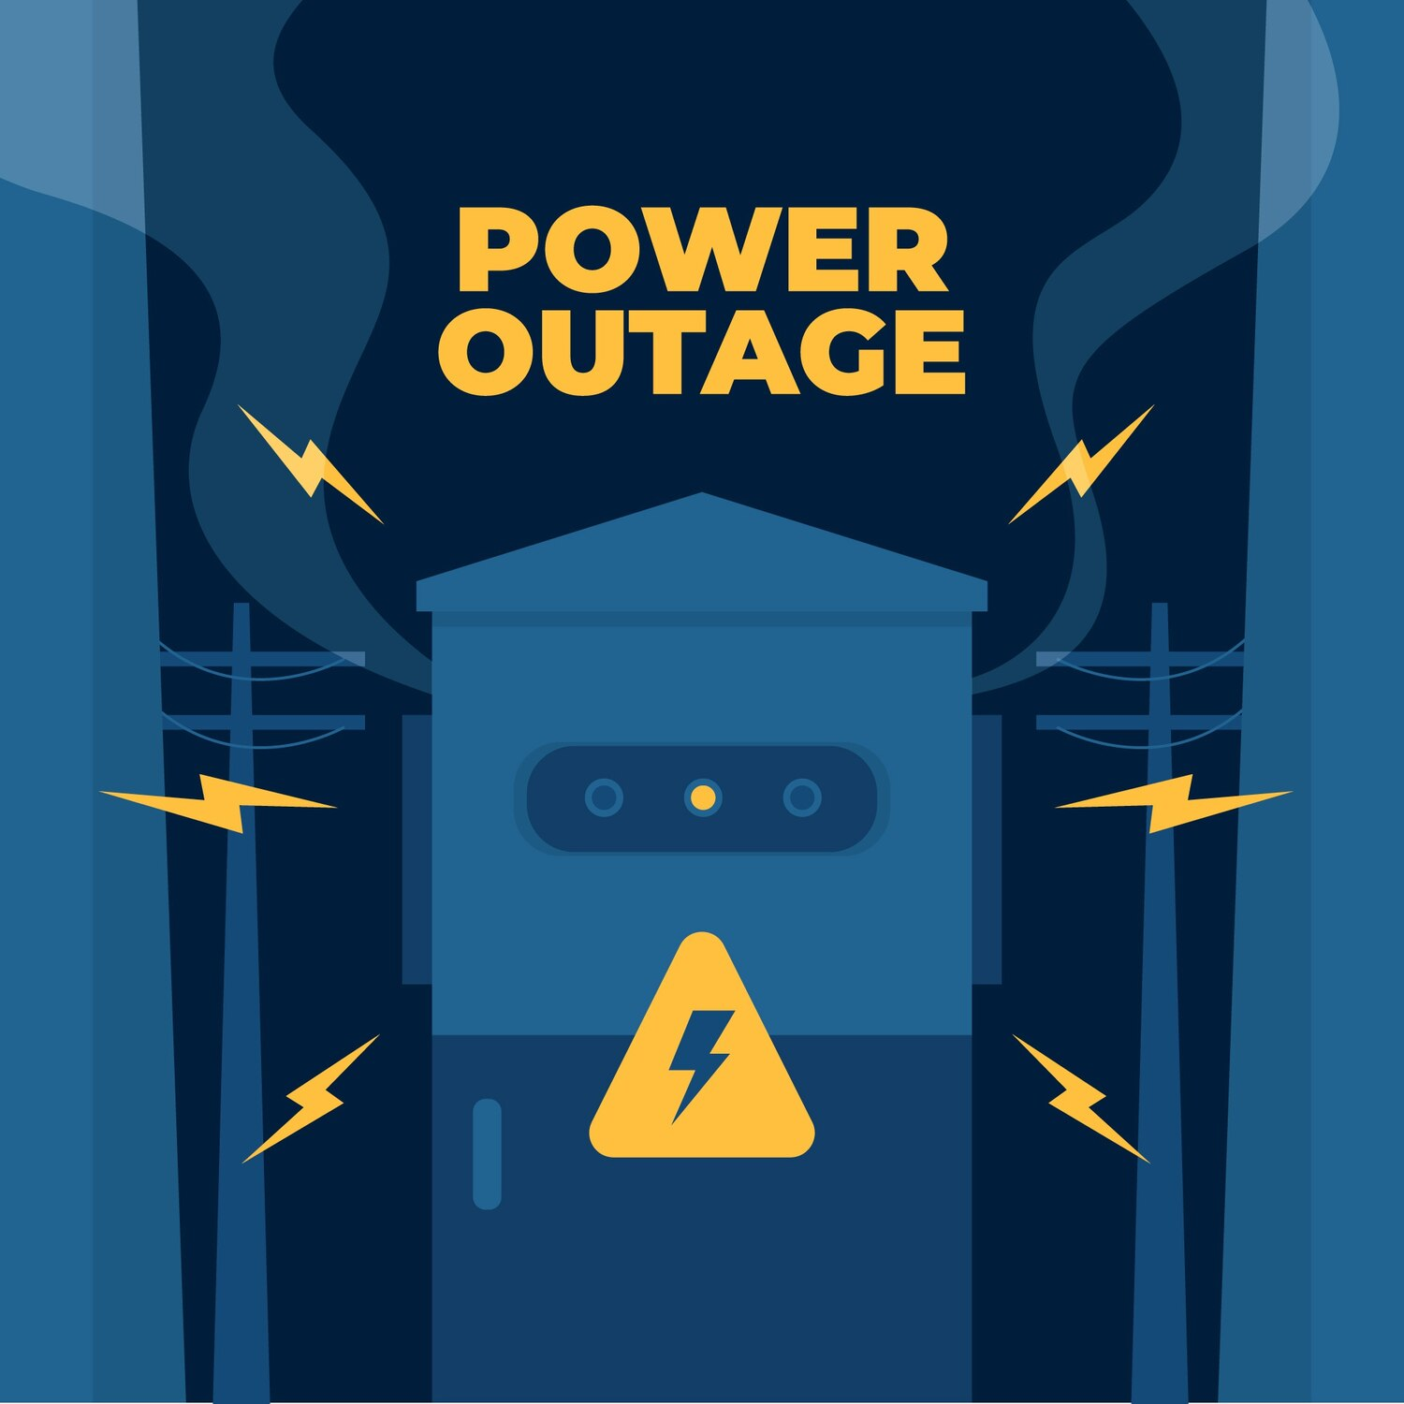
Introduction
The Uninterruptible Power Supply (UPS) project aims to ensure reliable power for enhanced performance. This presentation will cover the benefits, implementation process, and best practices for UPS systems.

Slide 5
Component List
• 220v to 9*2v 600Ma Transformer
• L7808CV Voltage regulator 8V
• Buck Converter LM2596
• Fixed Resistors (R1, R2,R3,R4)=1KΩ
• Variable Resistor (VR)=50KΩ
• Electrolytic Capacitor 570µF
• MOSFETs (BR50N06)
• IC CD4047
• Battery 12V
• 91L16 AC voltmeter
• 1N4007 Diode

Slide 6
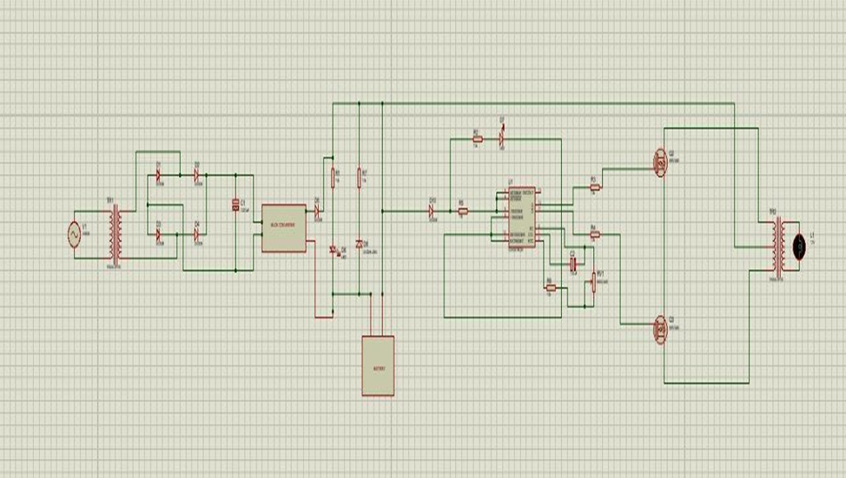
Circuit Diagram

Slide 7
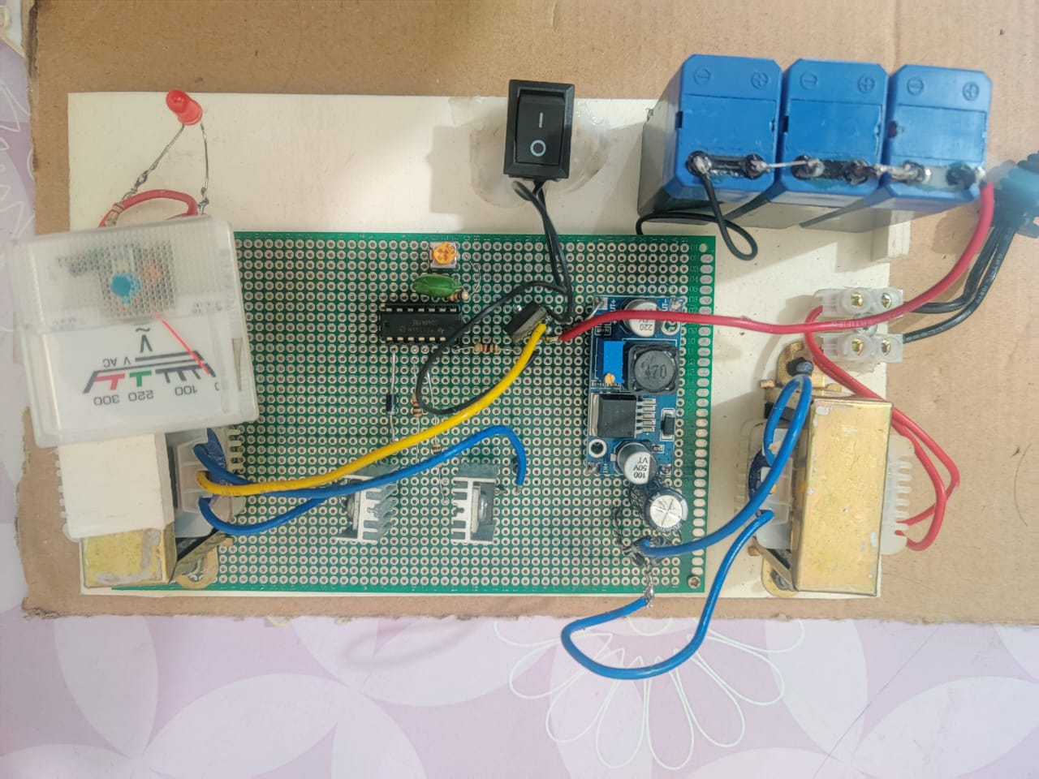
Circuit Diagram (Physical View)

Slide 8
Working Principle

Slide 9
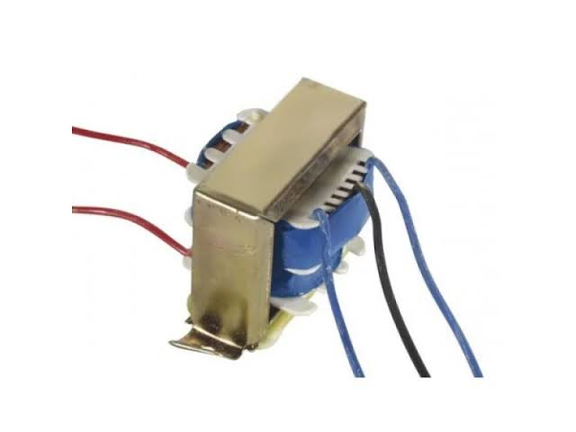
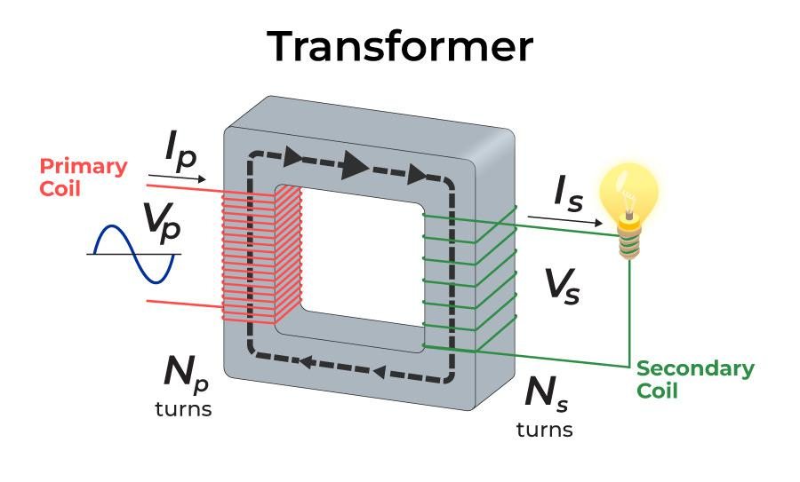

Step 1 : Input (Step Down Transformers)
Purpose of Step-down Transformer
Reason for Usage

Slide 10
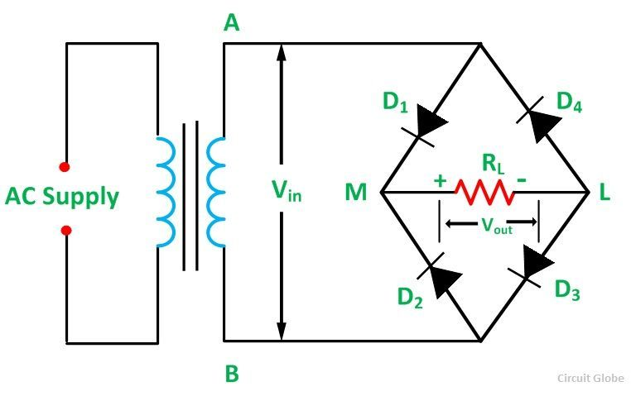
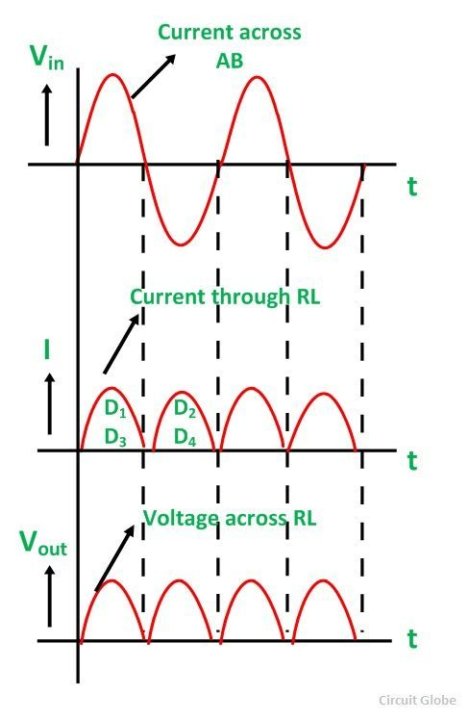
Step 2 : Rectifying
Rectifiers for AC to DC Conversion
Types and purpose of Full Wave Rectifiers

Slide 11
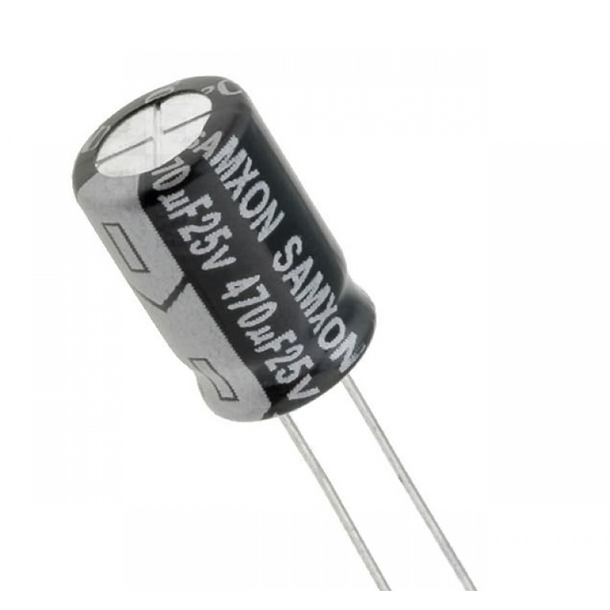
Step 3 : Noise and Ripple Reduction
Electrolytic Capacitor 470µF
Function of Electrolytic Capacitor in DC Filtering
Importance

Slide 12
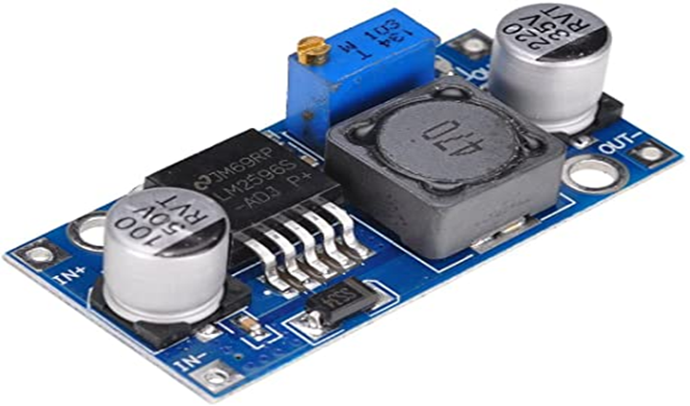
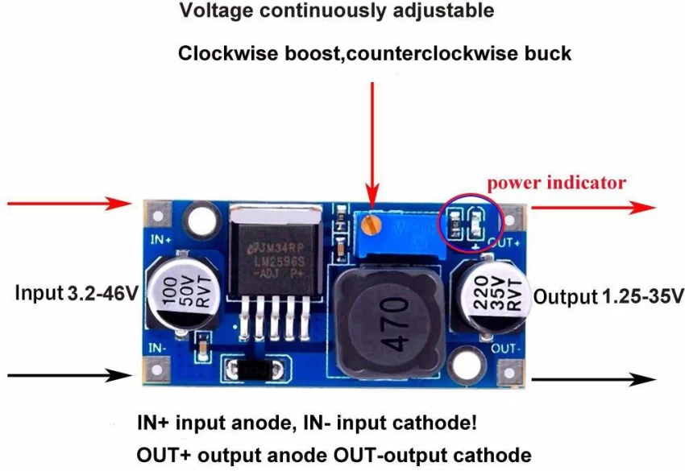
Step 4 : Buck Converter
DC to DC LM2596 Buck Converter :
Input Voltage : 4.5V - 35V
Output Voltage : 3V - 35V
Minimum Pressure : 1.5V
Output Current : Rated Current 2A , Maximum of 3A
Output Power : 15W maximum

Slide 13
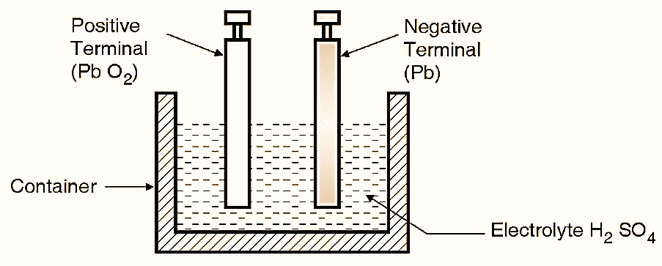
Step 5 : Lead Acid Battery

Slide 14
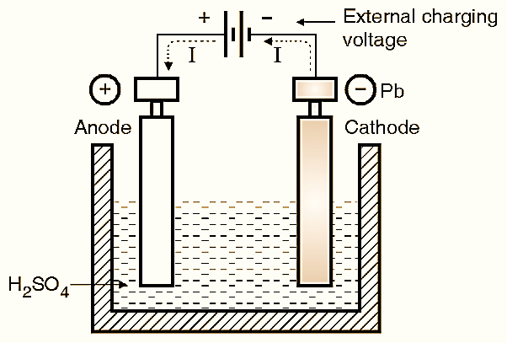
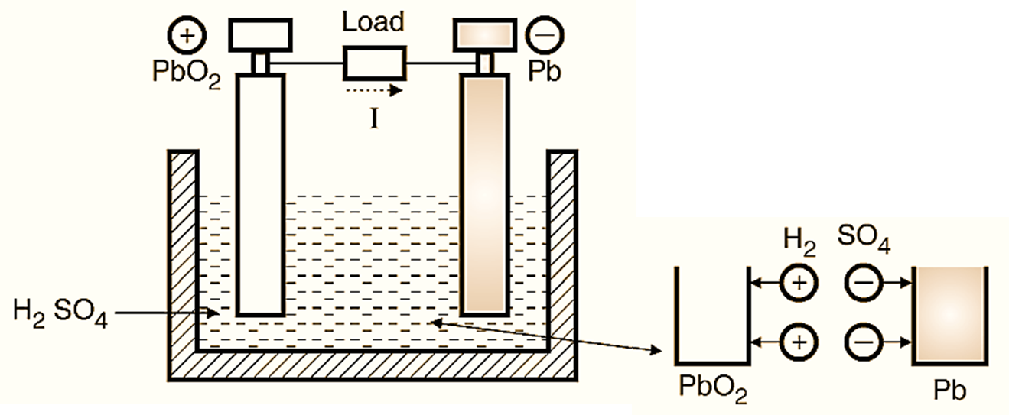
Step 5 : Lead Acid Battery (Charging & Discharging)
At Anode :
PbO2 + H2 + H2SO4→ PbSO4 + 2 H2O
At Cathode :
Pb + SO4→ PbSO4
At Anode :
PbSO4+SO4 +2H2O → PbO2+2H2SO4
At Cathode :
PbSO4+H2→H2SO4

Slide 15
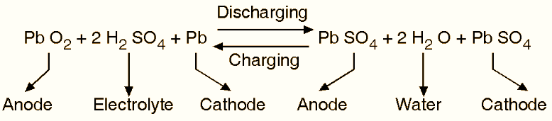
Step 5 : Lead Acid Battery (Charging & Discharging-Continued)

Slide 16
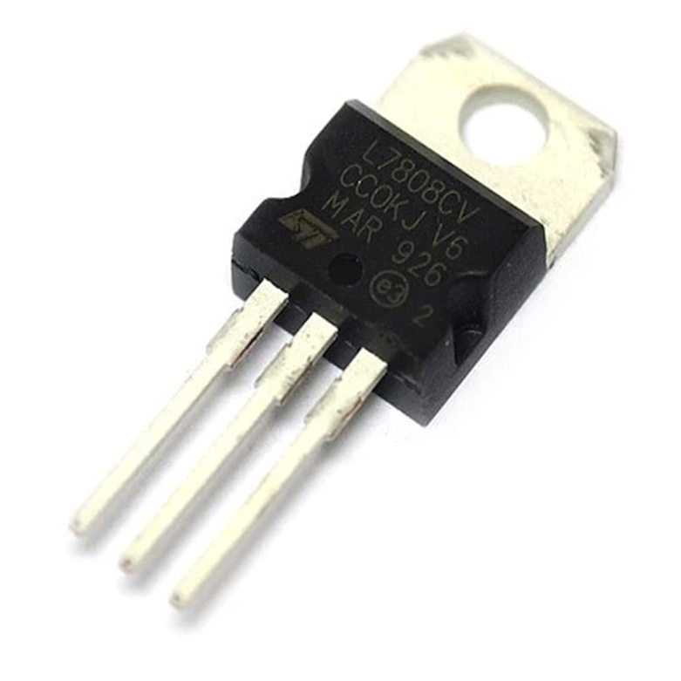
Step 6 : Voltage Regulator
Introduction
Output Characteristics
Input Voltage Range
Current Handling
Applications
L7808CV Voltage Regulator

Slide 17
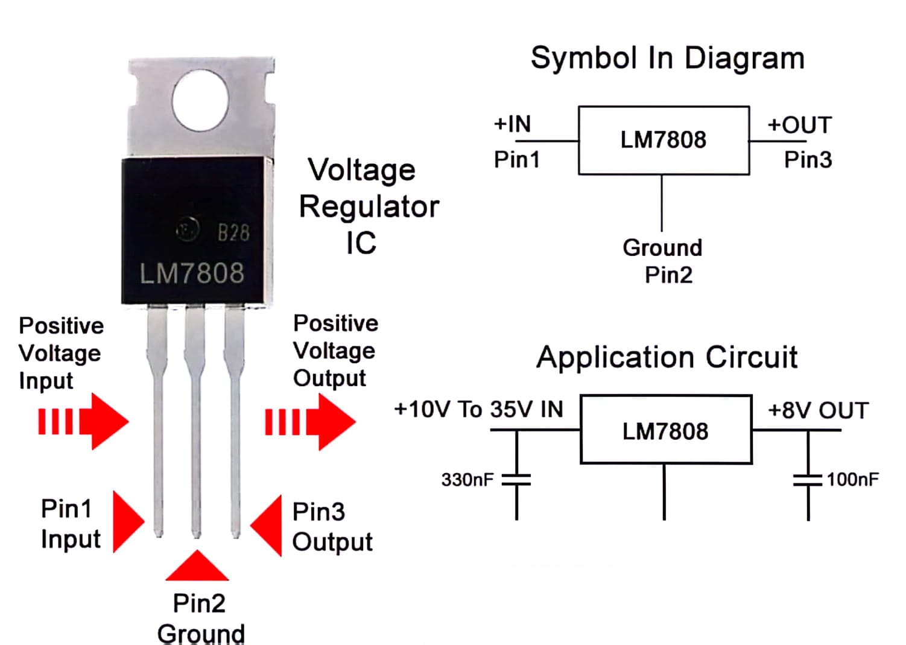
Step 6 : Voltage Regulator (Pin Diagram)

Slide 18
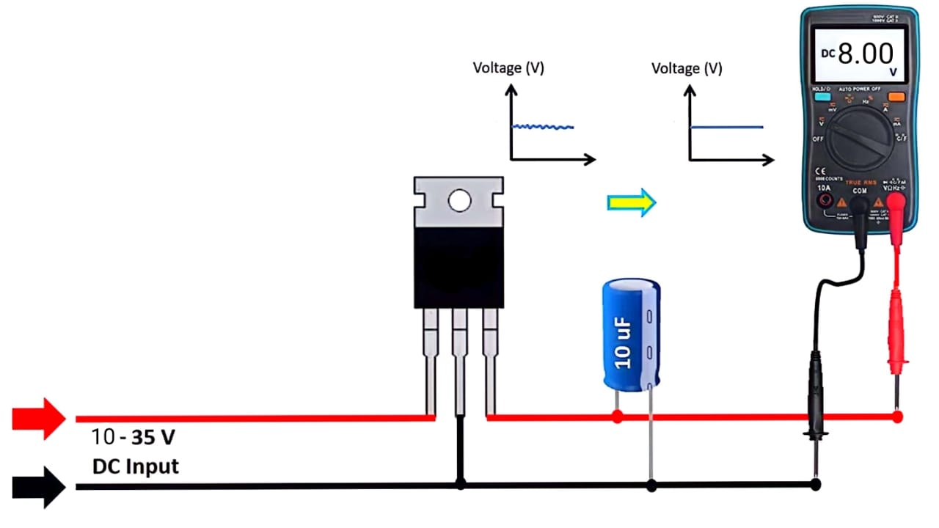
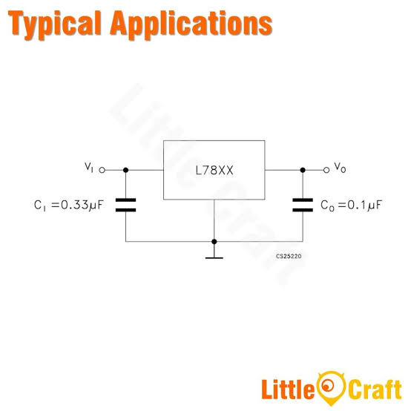
Step 6 : Voltage Regulator (Typical Application)

Slide 19
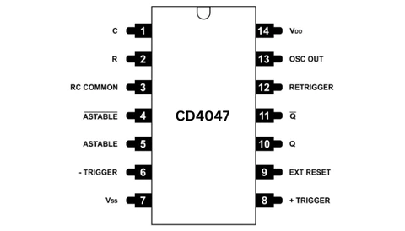
Step 7 : IC CB4047BE
CD4047 Description
Features
Inverter Control
DC to AC conversion
Frequency and Duty cycle
Control Efficient
Power Conversion
CD4047 IC Pin Diagram

Slide 20
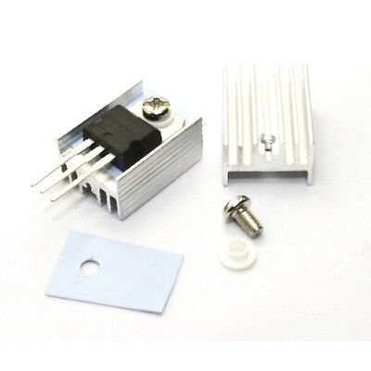
Step 8 : N-channel MOSFET Gate
Basic ups inverter operation
Role of n channel mosfet
Switching process
Heat generation
Heat sink
Importance of heat sink

Slide 21
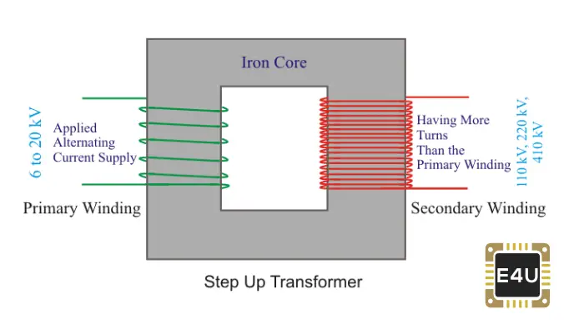
Step 9 : Step Up Transformer
Purpose of Step-up Transformer
Reason for Usage

Slide 22
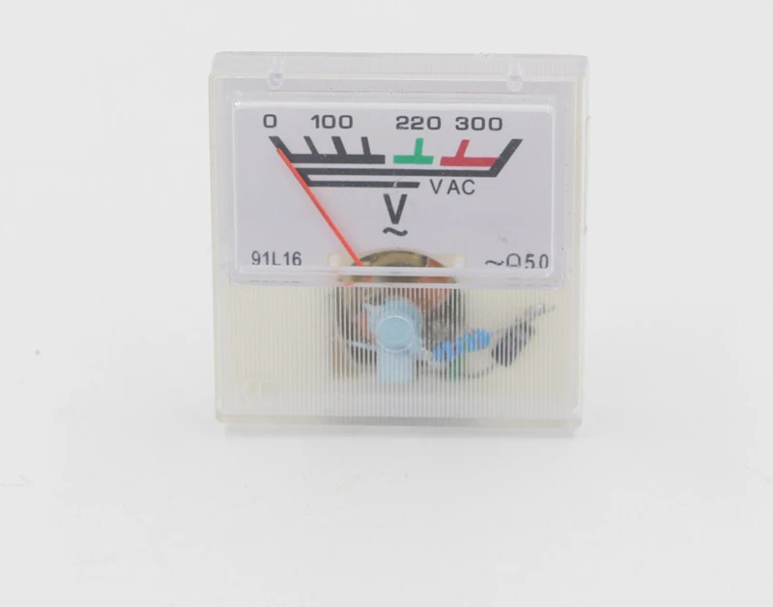
Step 10 : Measuring Output Voltage
91L16 AC voltmeter

Slide 23

Step 11 : Load and Switch
Switch

Slide 24
Advantages
Disadvantages
Uninterrupted Power Supply.
Equipment Protection against power fluctuations.
Data Integrity through prevention of sudden shutdowns.
Smooth Transition between mains power and battery backup.
Voltage Regulation for consistent power delivery.
Backup Time for safe shutdown during outages.
Remote Monitoring and management capabilities.
Versatility in various sizes and types.
Initial Cost may be relatively high.
Maintenance Requirements for regular checks and battery replacement.
Limited Backup Time, especially during prolonged outages.
Battery Replacement Costs due to a limited lifespan.
Size and Weight, particularly for larger units.
Environmental Impact of hazardous battery disposal.
Efficiency Loss in the energy conversion process.
Complexity of Installation for larger or advanced systems.

Slide 25
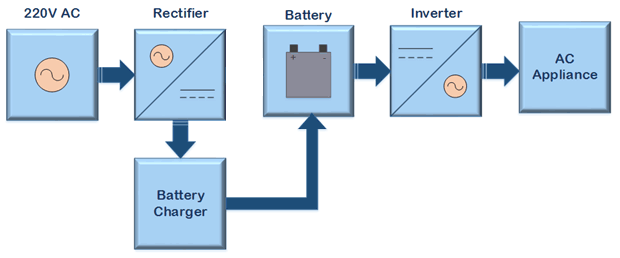
Overview

Slide 26
UPS vs IPS

Slide 27
UPS
IPS
In UPS, current is converted from AC to DC directly from the main, charging the battery for continuous use.
UPS transitions power in 3-8 milliseconds, providing a rapid and almost instant power supply.
UPS power is typically 2 kVA, suitable for a variety of applications.
UPS has automated voltage regulation set at 220V for stability.
More costly and complex than IPS
In IPS, the main power supply goes directly to the inverter, simultaneously charging the battery and providing output power.
IPS takes around 500 milliseconds for power transition, slightly longer than UPS.
IPS is typically around 16 kVA or more, operating in 3 phases, designed for higher power loads.
IPS maintains the same voltage as the main power supply, without automated regulation.

Slide 28
Importance of UPS
1. Preventing Data Loss
2.Equipment Protection
3.Business Continuity
4.Telecommunication Reliability
5.Healthcare Safety
6.Industrial Processes
7.Financial Security
8.Home Electronics.
9.Remote and Off-Grid Power
10.Emergency Services

Slide 29
Real Life Implements
Data Centers
Hospitals
Industrial Facilities
Ensures continuous power supply to servers and networking equipment
Supports critical medical equipment to avoid disruptions during power fluctuations
Maintains power to control systems and machinery, preventing production downtime

Slide 30
Real Life Implements
Emergency Services
Broadcasting and Media
Supports communication systems, dispatch centers, and emergency response equipmen
Supports broadcast equipment to prevent disruptions in live broadcasts

Slide 31

Conclusion
In conclusion, UPS systems play a vital role in ensuring reliable power for enhanced performance. By implementing best practices and leveraging advanced technologies, organizations can achieve seamless power continuity and mitigate risks associated with power disruptions.

Slide 32
THANKS!

